Slide 1

HR Matrix—A SaaS-Based HRMS: A Brief Overview
A comprehensive study examining the strategic impact and market potential of cloud-based Human Resource Management Systems in today's digital workplace.

Slide 2
Meet the Project Team
This comprehensive analysis was developed by a dedicated team of business analysts, leveraging their expertise to deliver key insights into SaaS-based HRMS solutions.
Sooraj Shetty
Kriti Sinha
Business Analyst
Business Analyst
Rushikesh Joshi
Business Analyst
The final presentation has been reviewed by our Lead Business Analyst, Swapnil Raut, ensuring accuracy and strategic alignment.

Slide 3
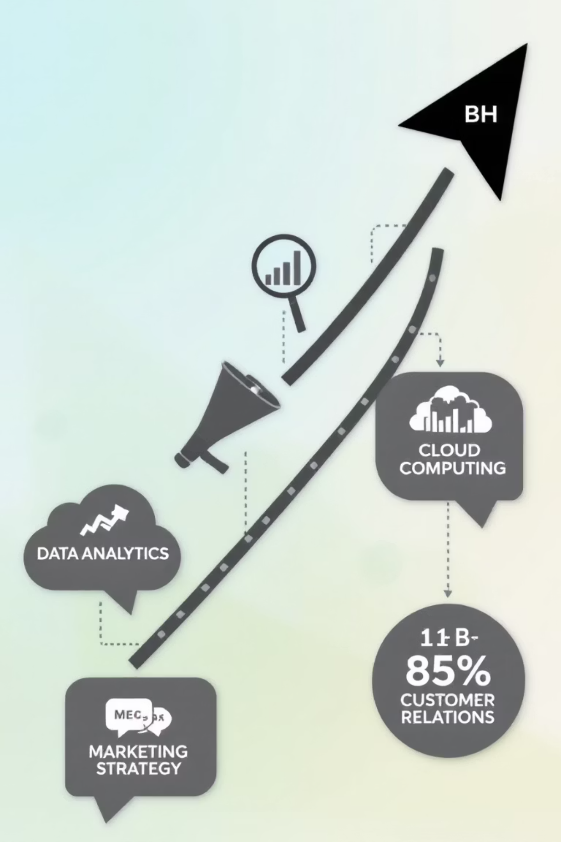
The Exploding Market for SaaS HRMS
$15.6B
$33.6B
57%
2020 Market Value
2028 Projection
Investment Intent
Global HR software market baseline
Expected market growth trajectory
Organizations planning SaaS HR adoption by 2029
Cloud adoption is being driven by the rise of hybrid work models and the critical need for scalable, flexible HR solutions that can adapt to changing workforce dynamics.

Slide 4
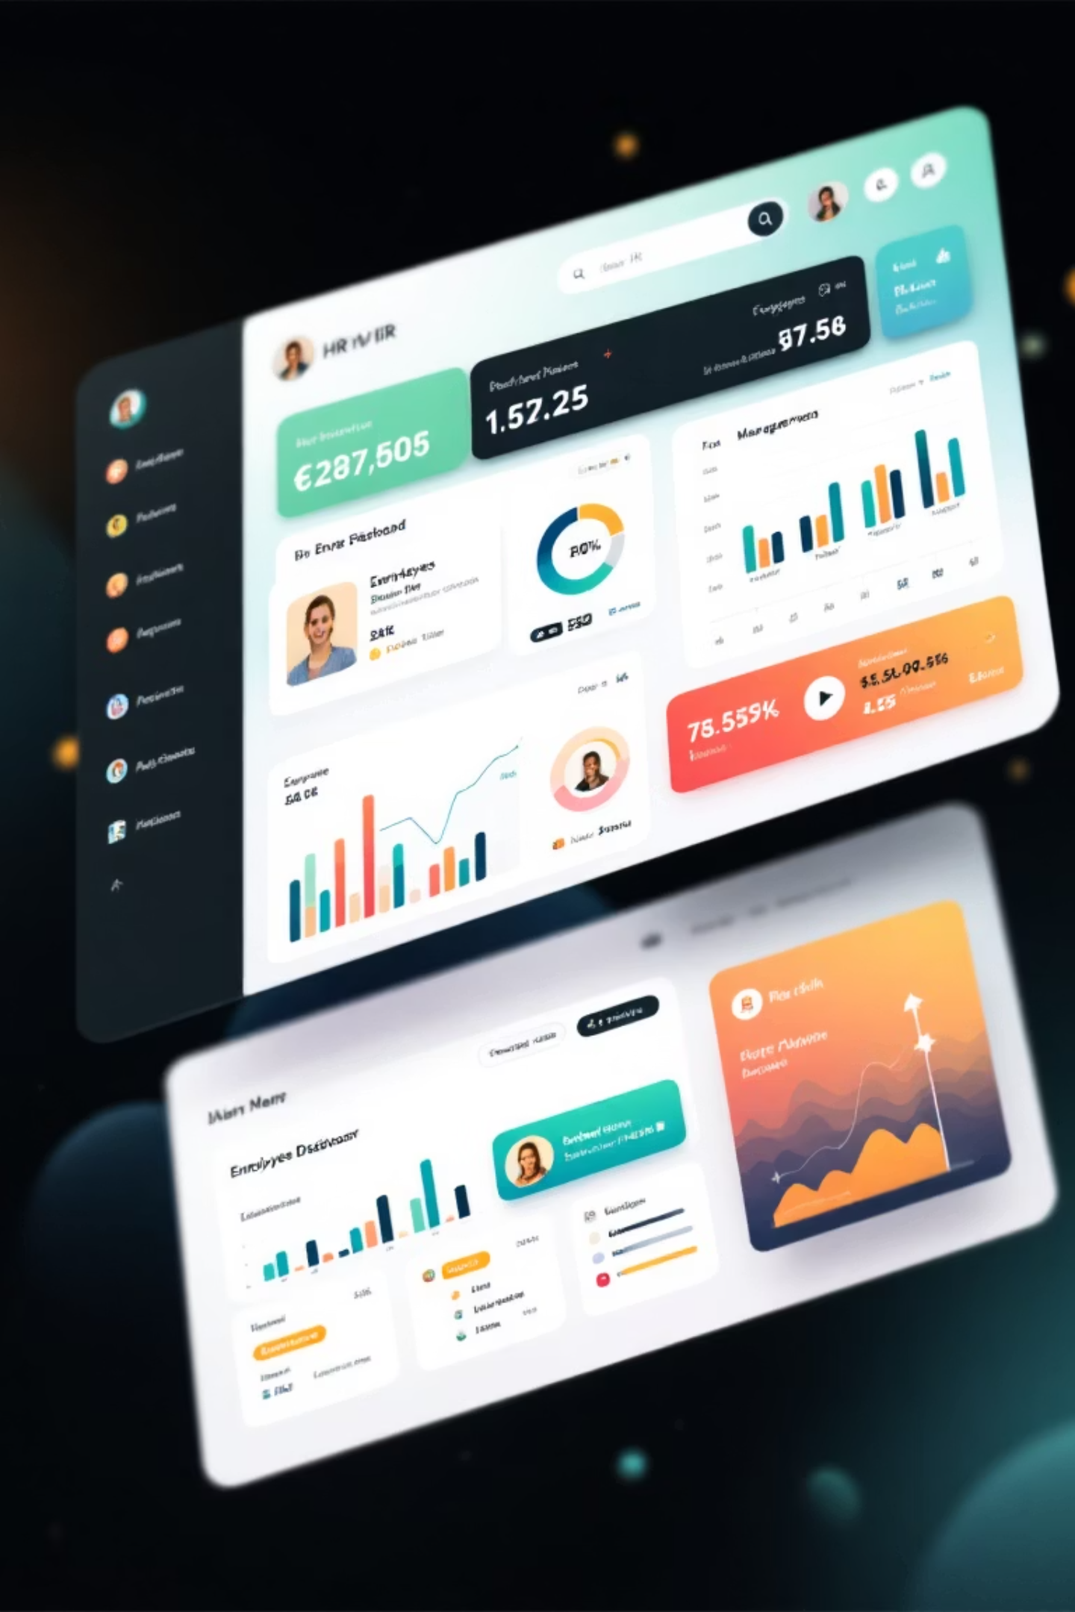



What is a SaaS-Based HRMS?
Cloud-Hosted Platform
Unified Integration
Browser-accessible system eliminating on-premise infrastructure needs
Combines recruiting, payroll, performance, benefits, and compliance management
Process Automation
Centralizes employee data while automating routine HR administrative tasks

Slide 5
Core Features Explored in the Project
Talent Acquisition
Employee Self-Service
Security & Compliance
Recruiting & onboarding automation streamlining new hire processes from application to first-day experience
Intuitive portals enabling leave requests, training enrollment, and personal data management with minimal HR intervention
Robust data protection features and regulatory compliance tools to ensure security and adherence to standards
Manager Self-Service (MSS)
Leave & Attendance Management
Empowering managers with tools to oversee team operations, approvals, performance reviews, and reporting
Automated tracking, approval workflows, and policy enforcement for employee leave and attendance

Slide 6





Strategic Benefits for Businesses
Time Optimization
Saves HR teams significant time by automating repetitive tasks, enabling focus on strategic workforce planning initiatives
Enhanced Engagement
Boosts employee satisfaction and retention through continuous performance insights and transparent career development pathways
Digital Efficiency
Eliminates paperwork and reduces errors with centralized, secure digital record-keeping and audit trails
Workforce Flexibility
Supports hybrid and remote workforces with secure anytime, anywhere access to critical HR functions

Slide 7
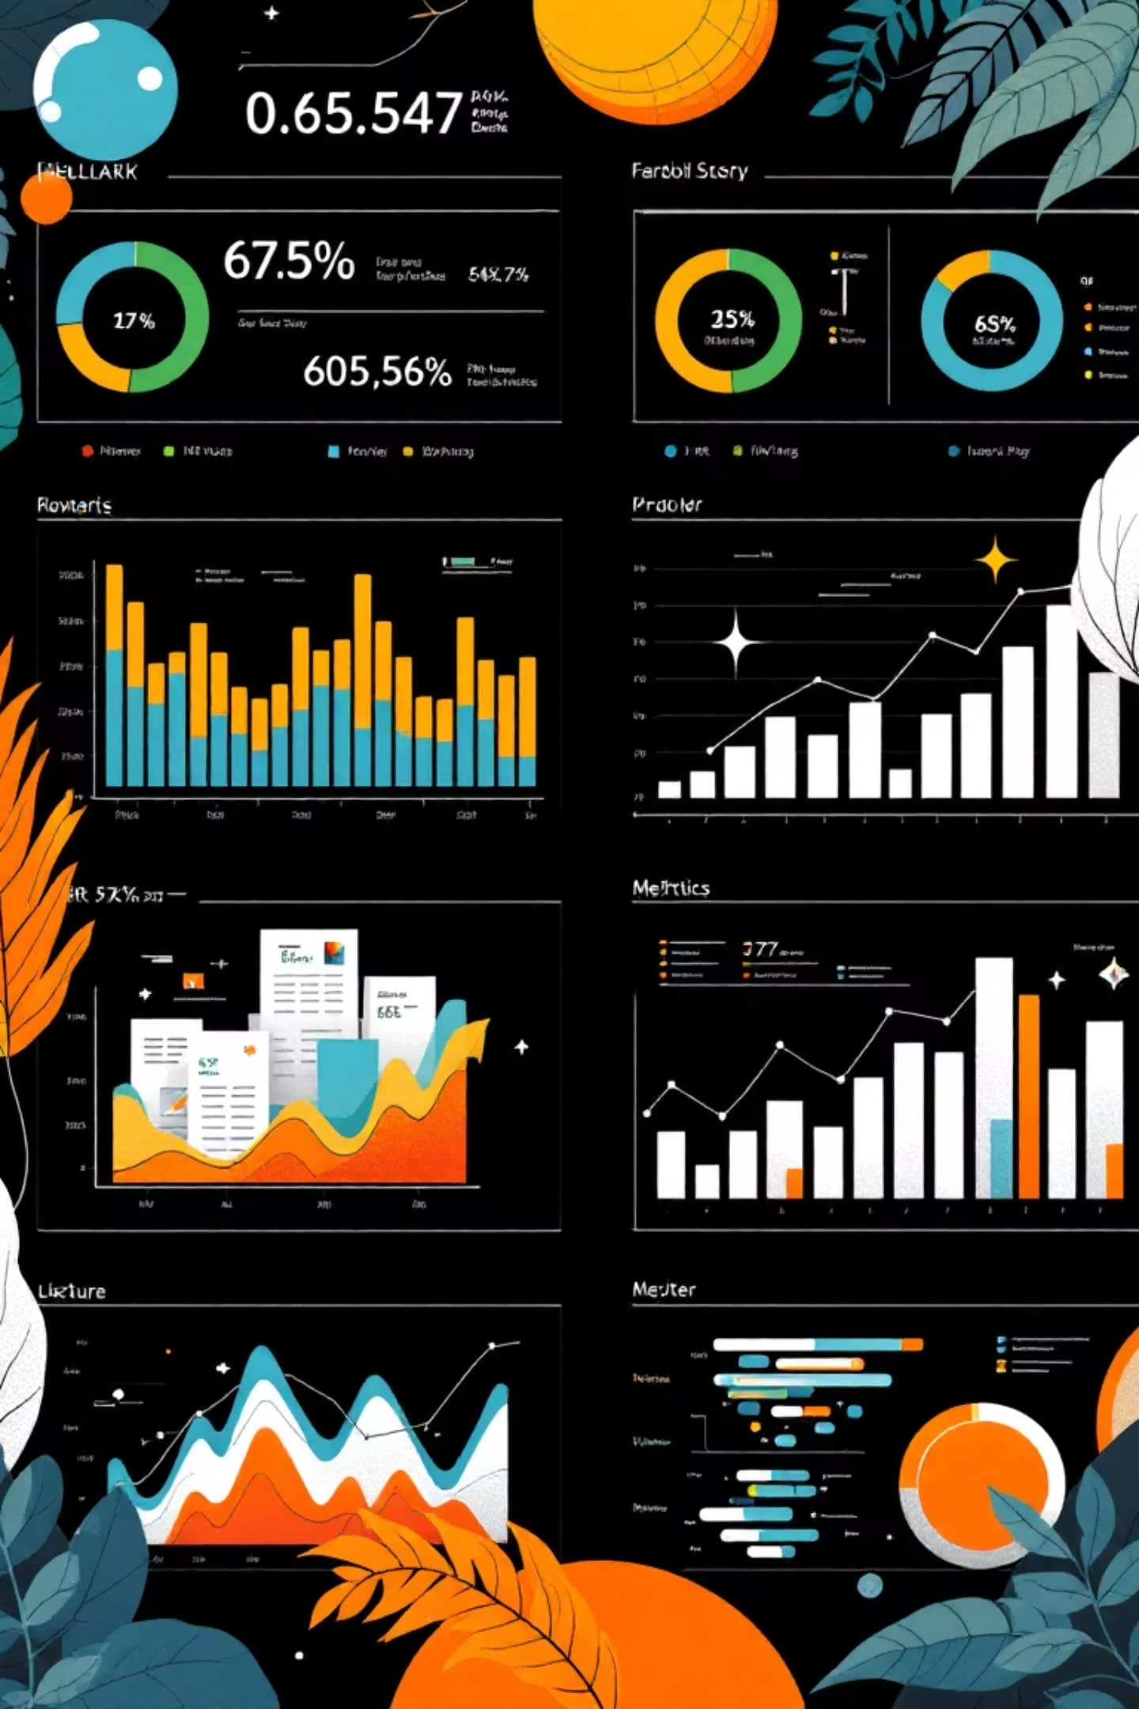



Advanced Analytics & Reporting Capabilities
Real-Time Dashboards
Comprehensive visibility into turnover rates, headcount trends, compensation equity analysis, and employee engagement metrics for informed decision-decision-making
Predictive Analytics
Advanced algorithms forecast future hiring needs and identify potential flight risks before they become costly turnover events
Strategic Insights
Data-driven intelligence empowers HR professionals to transition from administrative support to strategic business advisors driving organizational success

Slide 8

Competitive Landscape & Leading Solutions
Market Leaders
Key Differentiators
Pricing Models
Top SaaS HRMS providers include BambooHR, UKG, HiBob, and Deel, each commanding significant market share
Industry-specific features, comprehensive global payroll support, and advanced people analytics capabilities
Analysis reveals diverse approaches: subscription-based, custom quote-based, and freemium tiers for different market segments

Slide 9
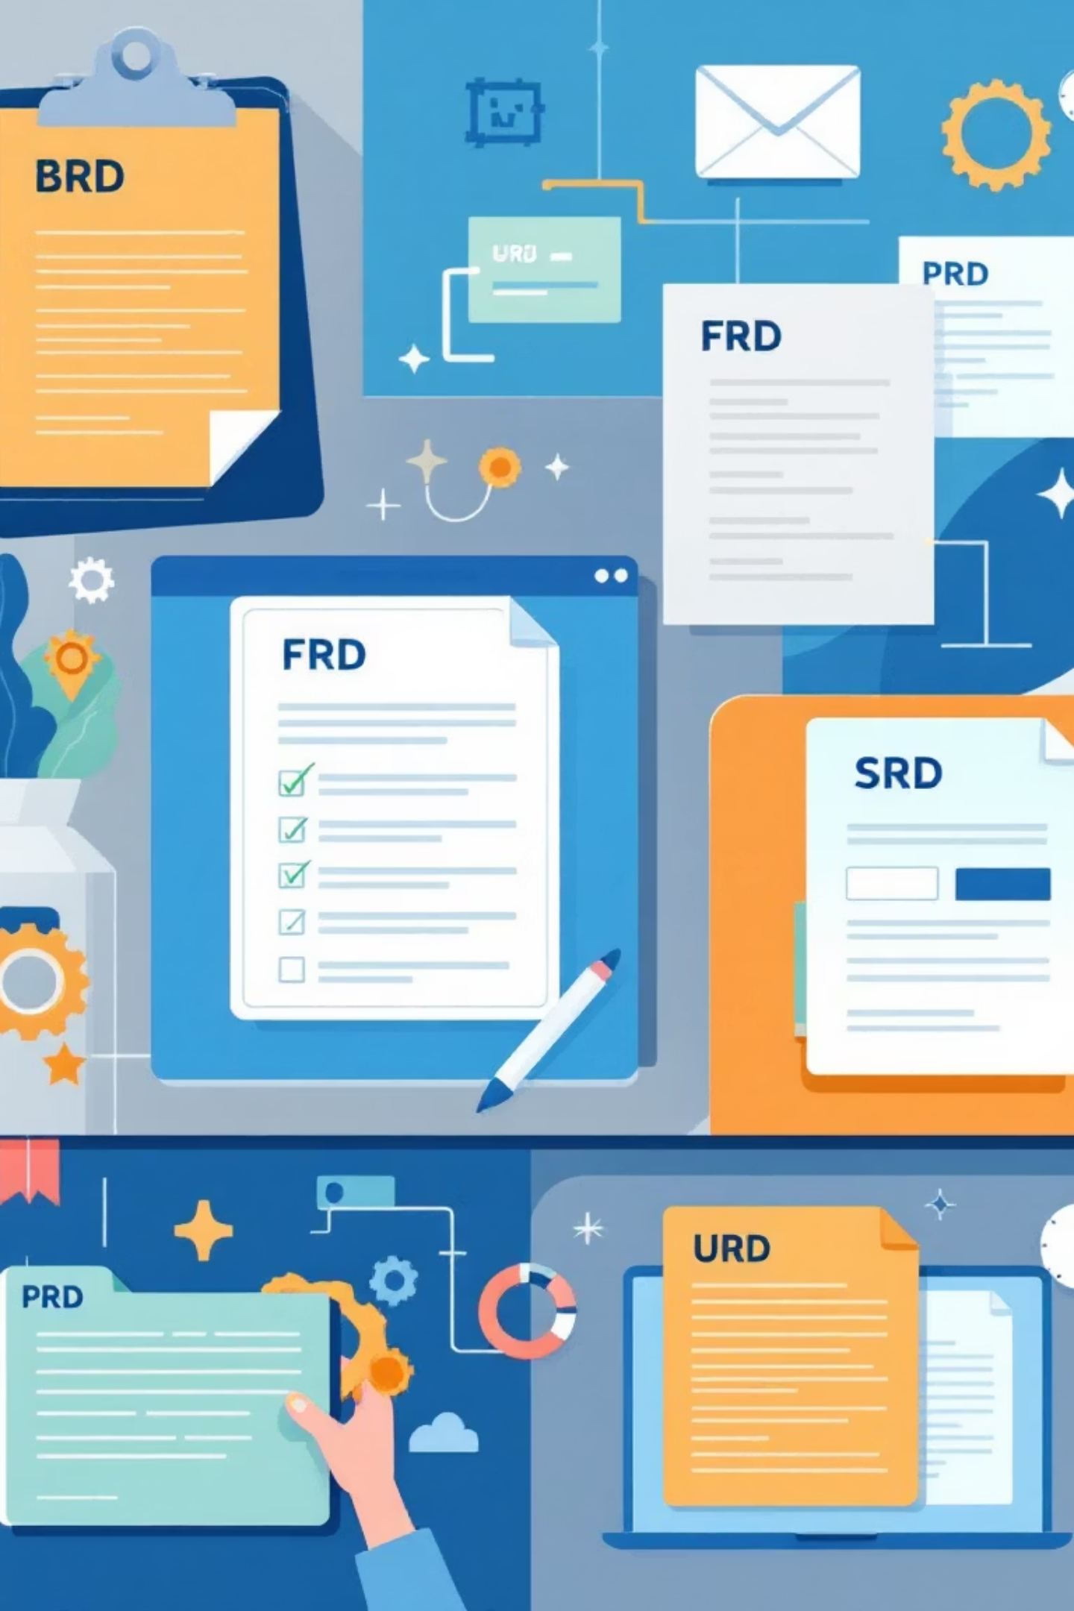





Key Project Outcomes
Our comprehensive business analysis culminated in a series of critical documents, each defining a crucial aspect of the SaaS HRMS project's success.
BRD: Strategic Alignment
FRD: Core Functionality
Clearly defined business objectives and stakeholder expectations, ensuring the HRMS solution addresses core organizational needs.
Detailed specifications for all system features, enabling development teams to build a robust and user-friendly platform.
PRD: Product Vision
SRD: Technical Foundation
Outlined the product's scope, features, and user stories, providing a roadmap for development and future enhancements.
Established the technical architecture, infrastructure, and performance requirements for a scalable and secure HRMS.
URD: User-Centric Design
Captured user needs and workflows, ensuring the system delivers an intuitive and efficient experience for all end-users.

Slide 10

Challenges & Considerations
Connectivity Dependencies
Customization Balance
Critical reliance on stable internet connectivity for seamless cloud access and system reliability during peak usage periods
Navigating the tension between unique organizational needs and standardized SaaS platform capabilities and limitations
Security & Compliance
Maintaining robust data security protocols while ensuring compliance with rapidly evolving privacy regulations across jurisdictions

Slide 11

Key Takeaways from the Business Analysis
HR Transformation Catalyst
SaaS HRMS platforms serve as critical enablers of comprehensive HR digital transformation initiatives
Operational Excellence
Seamless integration and intelligent automation drive measurable operational efficiency gains and enhanced employee satisfaction
Strategic Workforce Planning
Advanced analytics capabilities unlock sophisticated workforce planning and data-driven decision-making processes
Market Imperative
Accelerating market growth and evolving hybrid work trends make SaaS HRMS adoption a business imperative, not option

Slide 12
Thank You
Questions & Discussion
Ready to explore deeper insights from the comprehensive HRMS business analysis
Future Collaboration
Contact information available for continued dialogue on HRMS strategic implementation and optimization

